Slide 1
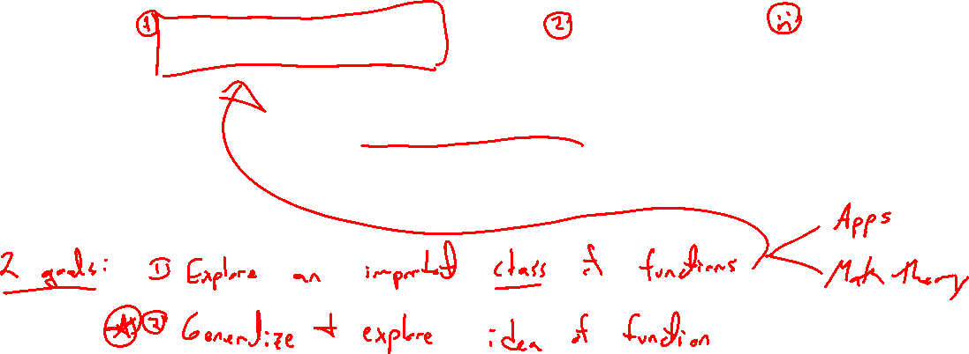
Chapter 3 Polynomial and Rational Functions
Introduction

Slide 2
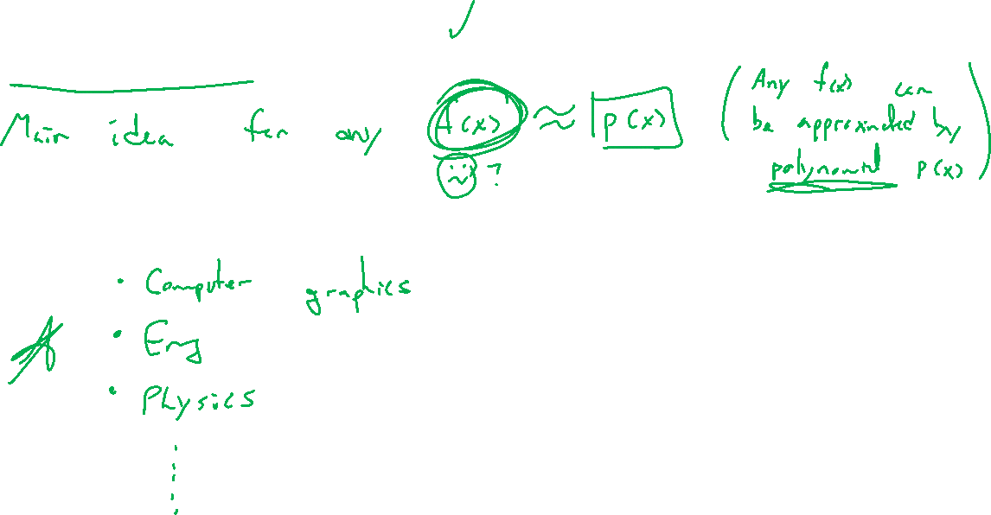
Application Usefulness
Notes:
Computer graphics, math modeling, physics
Splines, FE method, parabolas

Slide 3
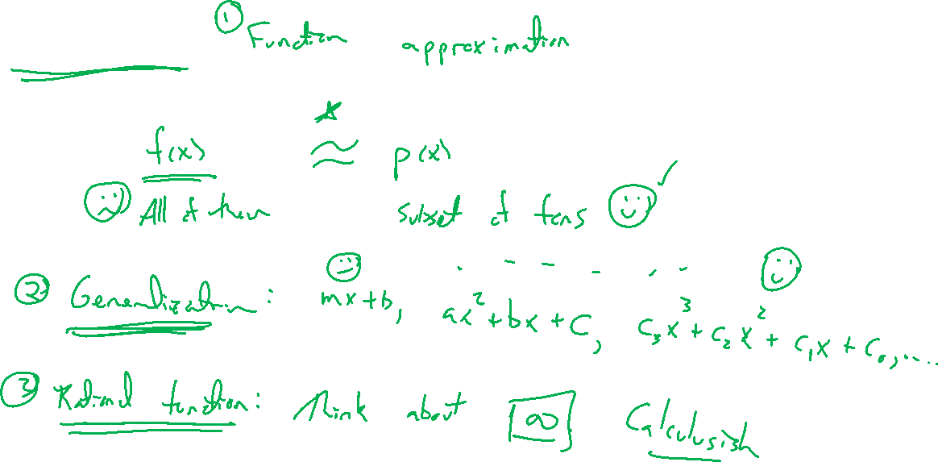
Mathiness
Notes:
Polynomial approximation, power series, fourier series
Generalization and math way
Study infinity with rational functions

Slide 4
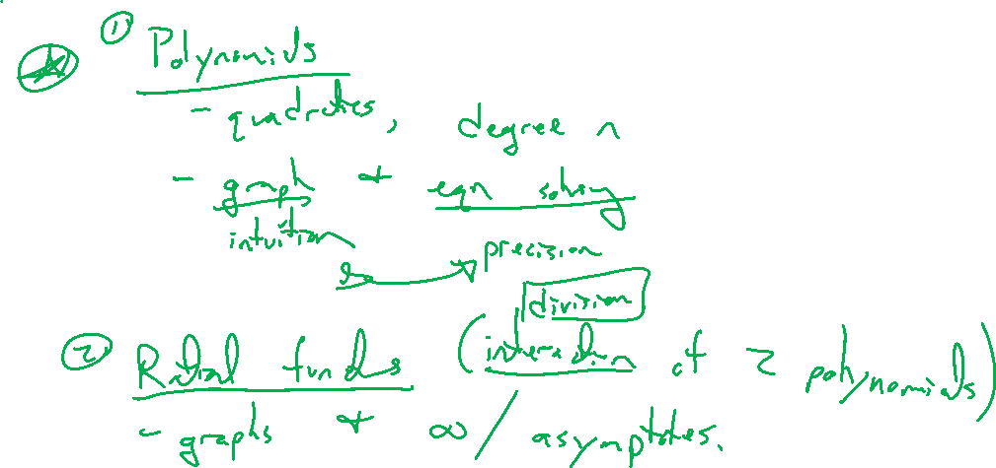
Outline of Chapter
Notes:
Polynomials
- quadratics, degree n, graphing and solving equations (balance of two main views)
Rational functions
- study infinity and complicated polynomial interaction (division)

